Slide 2




Developing a Framework to Analyze World Energy Consumption Using SAS® Enterprise Guide
Data Crusaders
Niharika Bandlamudi
Ki Jeong
Nupoor Karnik
Gagana Uday Kumar
Notes:
Hello, my name is Niharika here with teammates Ki, Nupoor, and Gagana. We are team Data Crusaders representing the University of Texas at San Antonio. This presentation will be on our data analysis and exploration on world energy consumption using SAS Enterprise Guide.

Slide 3


Data Source
World Energy Consumption Data: https://www.kaggle.com/datasets/nirmalprasad/world-energy-consumption
World Population Data: https://data.worldbank.org/indicator/SP.POP.TOTL
Notes:
For our research, we selected two datasets. These are the world energy consumption data from Kaggle and world population data from the World Bank. The world energy consumption data contained years 1965 to 2021, and includeds variables which are Country, region, type, Energy consumption, and year. The world population data contained years from 1995 to 2022 and included variables which are Country name, country code, Indicator Name, Indicator Code and year.

Slide 4

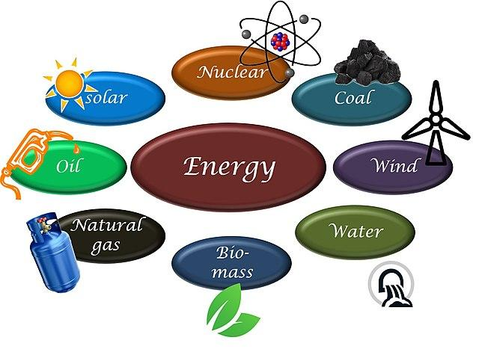
Problem Statements
To investigate correlation between population size and energy consumption.
To analyze per capita renewable and non-renewable energy consumption across countries.
Notes:
Here, we will be investigating correlation between energy consumption and population. We will also be analyzing the per capita renewable and non renewable energy consumption across the countries.

Slide 5


Data Cleaning and Exploration
Notes:
So let’s start with data cleaning and exploration.

Slide 6
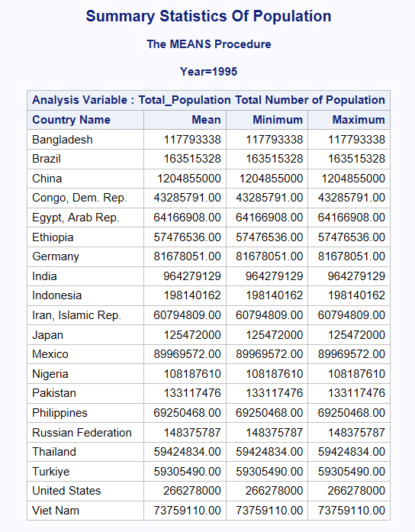
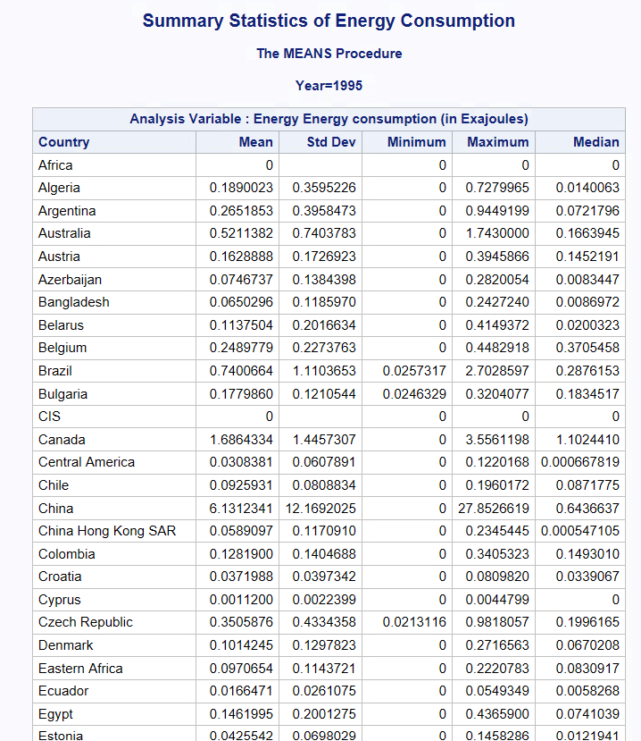
Summary Statistics for Population and Energy Consumption (Pre-Cleaned)
Notes:
The tables you see here are the pre cleaned summary statistics of world population and world energy consumption data. As you can see there are some differences in the names of the countries in population tables- e.g the way Viet Nam is written at the end of table. There were also many 0s in the Energy consumption table where data was not available.

Slide 7
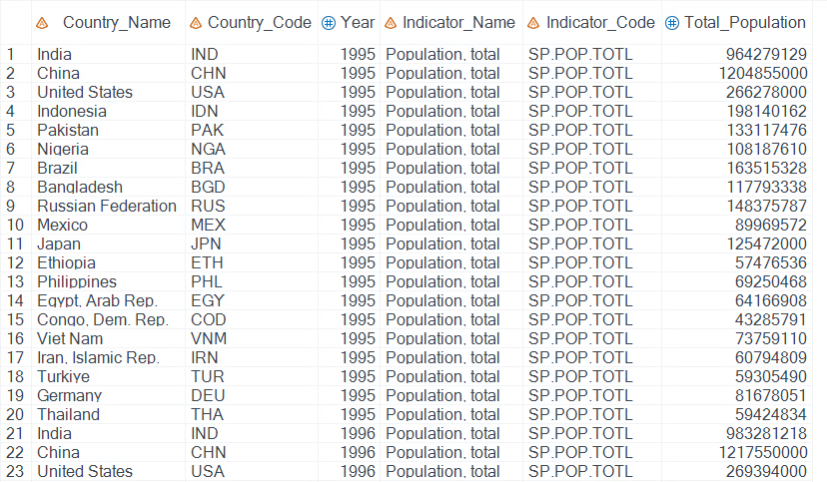
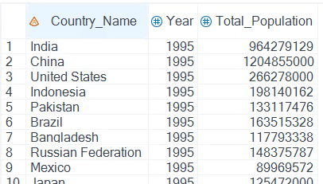

Created a new table ‘population’ that selects top 20 most populous countries, years, and total population from World Population dataset.
This table will later be merged with World Energy Consumption dataset.
Notes:
To overcome that, we created a new table named ‘population’ that selects top 20 most populous countries along with their years and total population from the world population dataset. This table will later be merged with World Energy Consumption dataset.

Slide 8
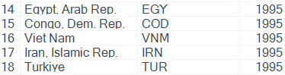
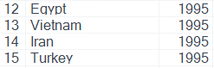
Standardized country names across both datasets to ensure consistency
Removed 'Nigeria,' 'Ethiopia,' and 'Congo, Dem. Rep.' from the new 'population' table due to their absence in the World Energy Consumption dataset
Notes:
Then we standardized the country names in both the datasets for consistency. We removed Nigeria, Ethiopia and Democratic Republic of Congo from the new population table as the data for these countries was not available in the energy consumption data.

Slide 9
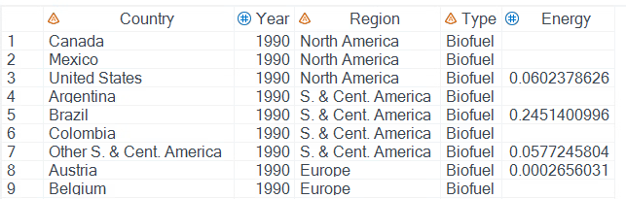
World Energy Consumption Data included the columns year, region, type of energy consumed and energy in exajoules.
Replaced the 0's with null value for energy column of world_energy_consumption table to prevent their inclusion in average calculations.
Notes:
In the energy consumption data we included variables year, region, ‘type’ of energy consumed and ‘energy’ in exajoules. The variable ‘energy’ had a lot of 0s where data was missing, because not every country utilized all types of energy resources. Some were bound to have missing values in the table, so we replaced them with null values to prevent their inclusion in average calculations.

Slide 10
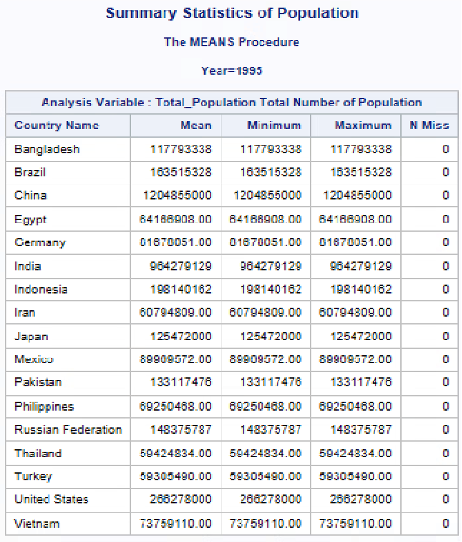
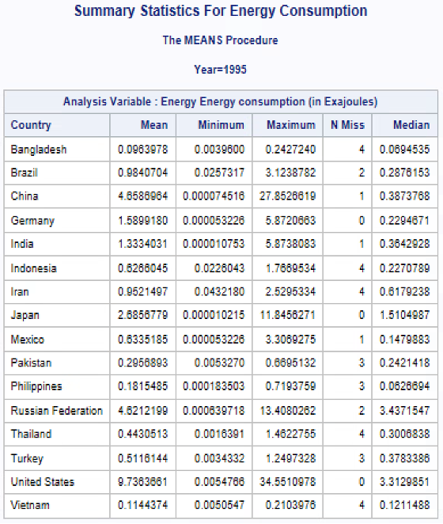
Summary Statistics for Population and Energy Consumption (Cleaned)
Notes:
After cleaning the data, this is how the summary statistics of both tables looked. You can see the countries are the same and ready for further analysis.

Slide 11
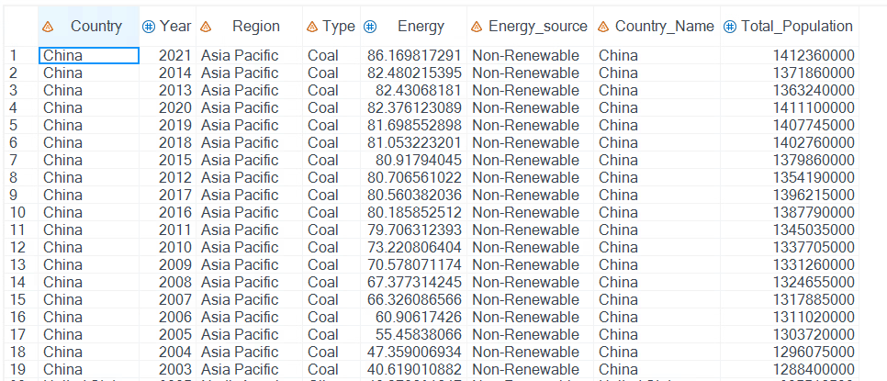
Merging Energy Consumption and Population Tables
Inner join of Energy Consumption and Population with Country name column was used for further analysis.
Added a column named Energy_Source and categorized type of energy by (Renewable/Non-Renewable) e.g Coal-NR and Wind-R
Notes:
In the next step we merged both tables with inner join using sql procedures and added a variable named Energy_Source to categorize the type of energy in renewable or non-renewable.

Slide 12


DATA ANALYSIS
Notes:
Now, let’s continue with data analysis

Slide 13
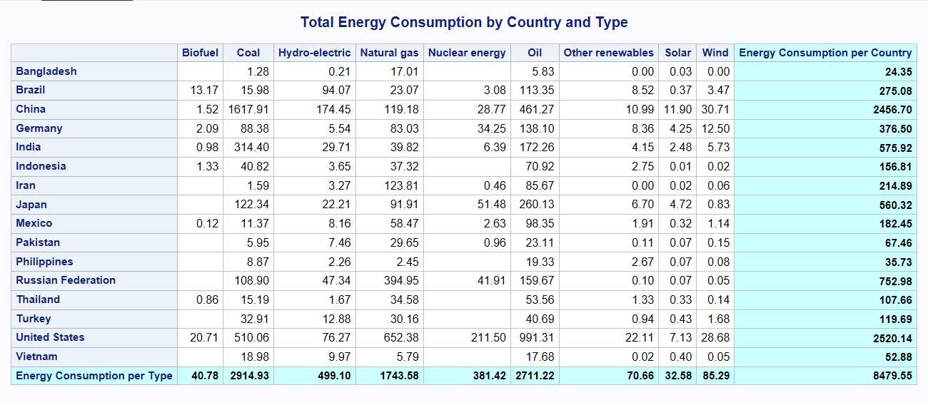
Summary Table For Total
Notes:
This table illustrates the total energy consumption by country and the type of energy resources used from 1995 to 2021.
The United States leads in energy consumption, followed by China. An intriguing observation is that, despite India being among the top 5 countries in terms of population for most years, its energy consumption remains relatively low. This could be attributed to India's smaller total area compared to the US and China.
Across all these countries, coal emerges as the primary source of energy consumption, followed by oil.
We utilized the summary table wizard to create this table. This generates customized and visually appealing reports, highlighting total columns for easy interpretation.

Slide 14
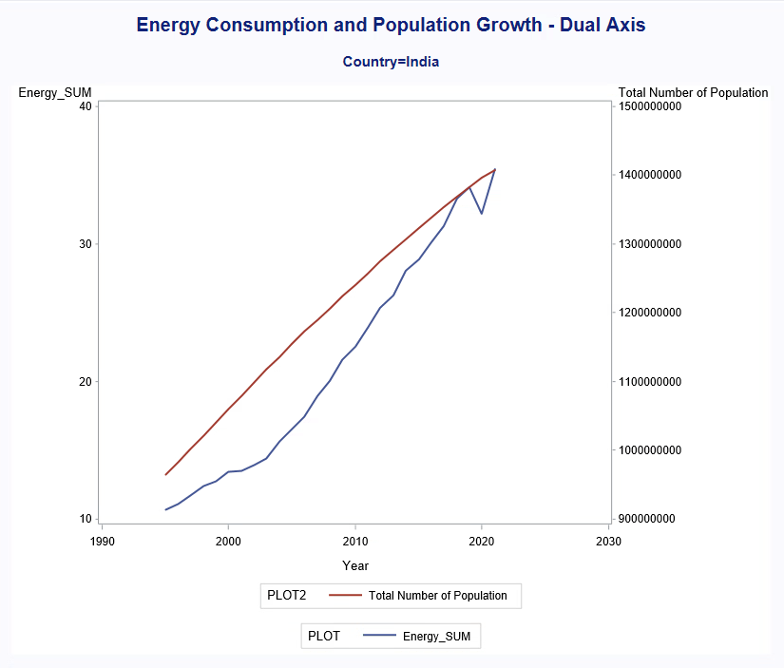
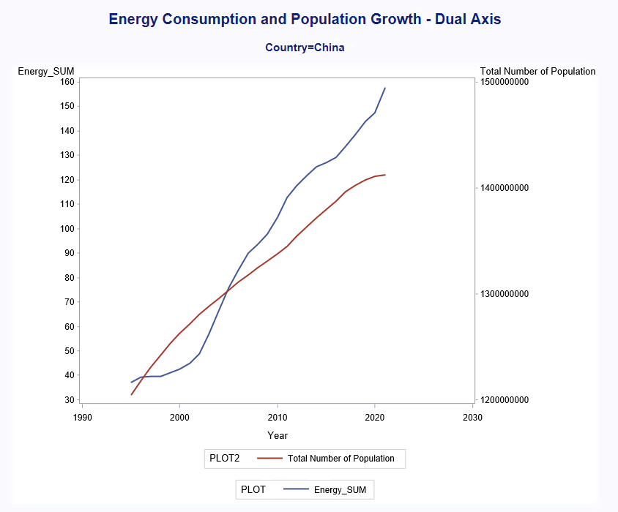
Correlation Of Energy Consumption and Population
Population and energy consumption were correlated for 13 countries (76.47% of data)
Time Series graphs indicate the same.
Notes:
After examining the intricacies of energy consumption by countries, let's explore the correlation between energy consumption and the population of these countries. It's commonly assumed that as the population increases, energy consumption also increases. We observed this trend for 13 countries, which attributed for 76% of the total energy consumption. For example, in countries like China and India, we see that as the population increased, energy consumption also increased.

Slide 15
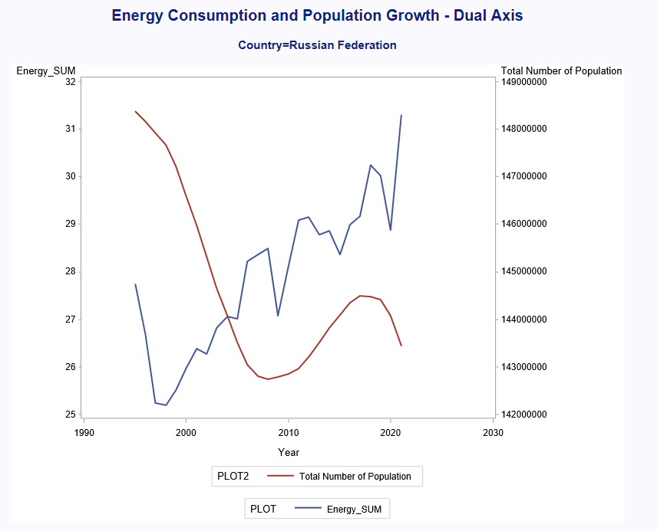
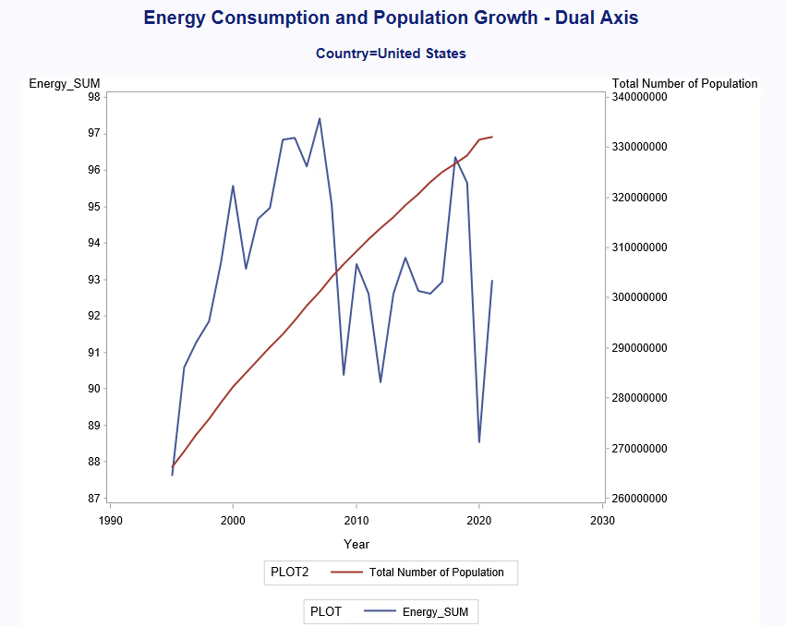
No correlation found between population and energy consumption for 4 countries i.e., 23.5% of the data.
Notes:
However, an interesting observation was that for four countries, which attributed for 24% of the dataset, there was no clear correlation between energy consumption and population. These countries included Germany, the US, Japan, and Brazil. For example, in Russia, we observed a scenario where the population appeared to be decreasing while energy consumption was increasing. Similarly, in the US, although the population seemed to be increasing, there was significant fluctuations in energy consumption.

Slide 16
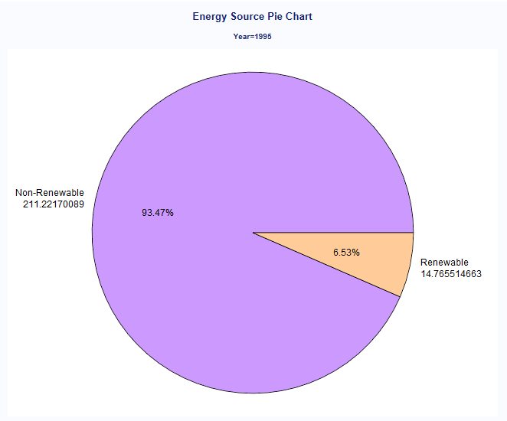
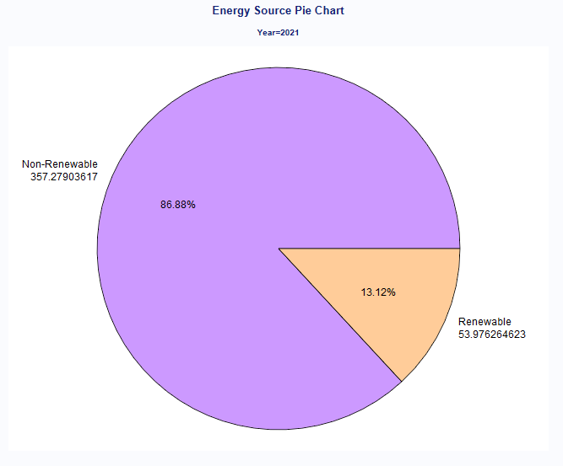
Gradual Increase Of Renewable Energy Consumption From 1995 - 2021
Notes:
Here we show the comparison between renewable and non-renewable energy sources. We have aggregated the data from all countries for each year from 1995 to 2021 to analyze the type of energy used.
In 1995, only 6.53% of renewable energy sources were being utilized, while 93.47% were from non-renewable sources.
However, by 2021, we see a shift, with 13.12% of renewable energy sources being used compared to 86.88% of non-renewable energy sources. This trend suggests that renewable energy consumption is gradually increasing, and there may come a time when it surpasses non-renewable energy consumption

Slide 17
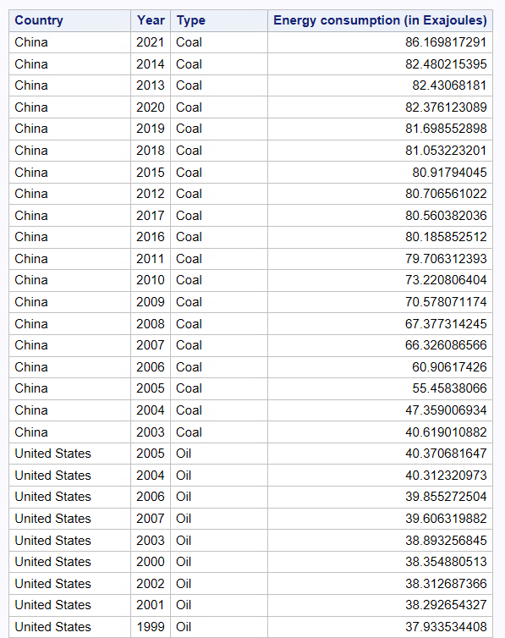
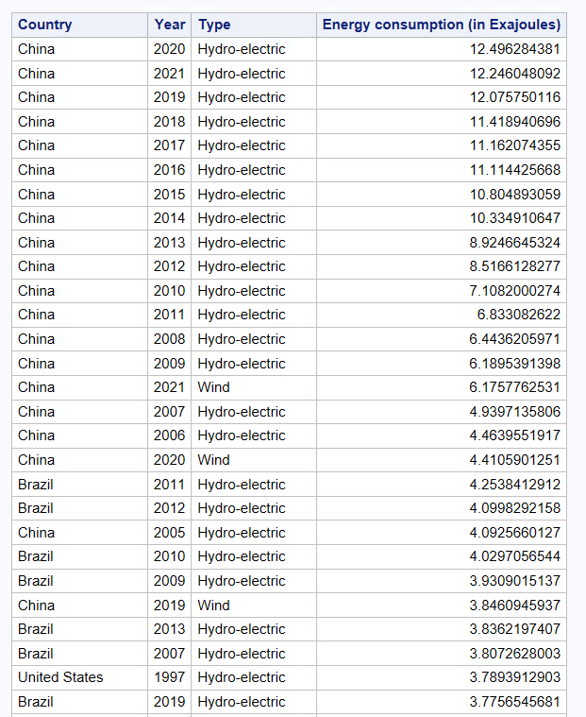
Countries Above Total Temporal Average Energy Consumption
Output shows countries with years that surpass average energy usage (renewable and nonrenewable)
Used inline view.
Non-renewable
Renewable
Notes:
We define total temporal average energy consumption as the combined average of both renewable and nonrenewable energy across the entire year range – so from 1995 to 2021. Then we generated two tables (one for renewable and one for nonrenewable) with countries that surpassed this total average along with the year and the type of energy that was associated. These tables were then ordered in descending order. From the non-renewable table, China occupied the top spots every year since 2003 with coal as the dominant energy consumed. Renewable table showed similar results with China at the top, followed by Brazil or United States

Slide 18
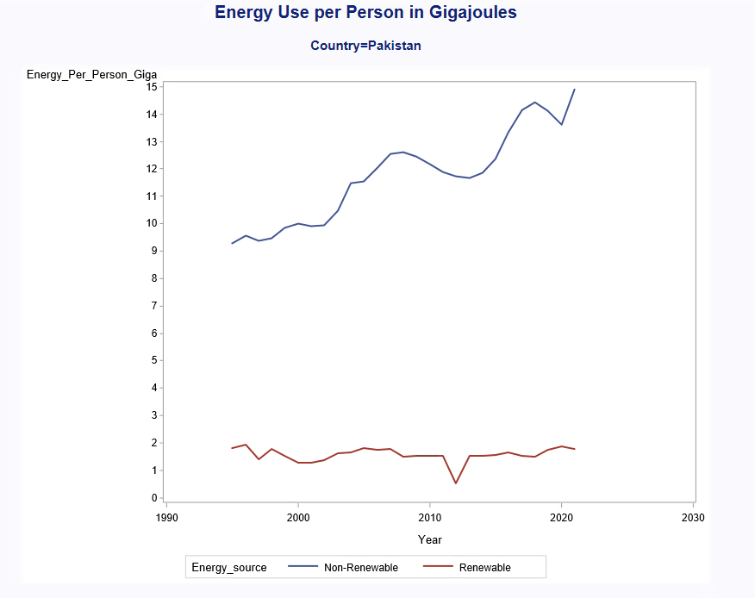
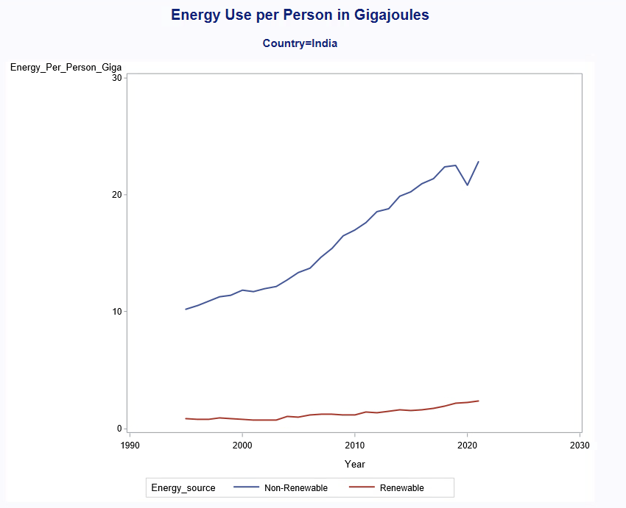
Per Capita Usage of Non-Renewable And Renewable Energy
Increase in non-renewable energy use per person was observed, but very slow to no growth in renewable energy use
This trend is observed for 13 countries (76.47% of data)
Notes:
Next is the per capita use of non-renewable and renewable energy. For most countries, there was an increase in non-renewable energy use per person, but little to no growth in renewable energy use. The graphs below show Pakistan and India following this pattern. This kind of trend represented 13 of our 17 countries, which was 76.47% of our data.

Slide 19
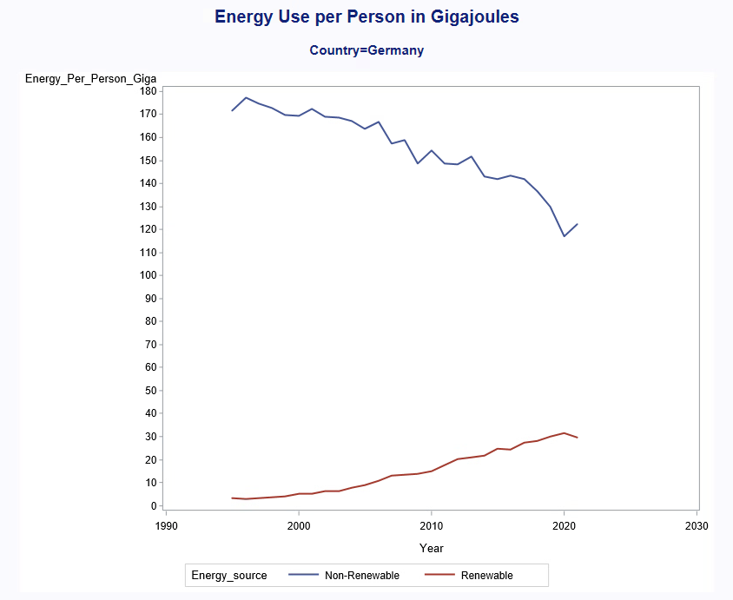
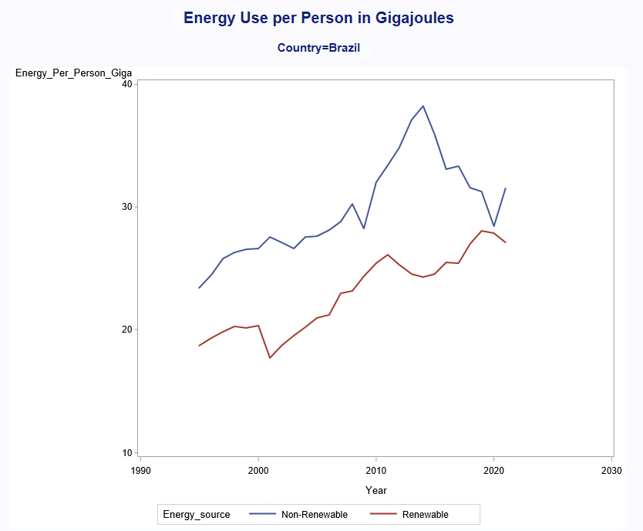
Per Capita Use of Non-Renewable And Renewable Energy
Gradual decrease in non-renewable energy use per person was observed while renewable energy use was increasing
This trend was observed for 4 countries (23.53% of data)
Notes:
But for some countries, there was a decrease in non-renewable energy use while renewable energy use was increasing. The graphs below show Germany and Brazil following this pattern. This trend represented 4 of our 17 countries, which was 23.53% of our data.
Interestingly for Brazil, this trend emerges after 2013. After more research, we believe this was due to Brazil’s policy started in 2013 called “The ten year for the expansion of energy”. This ambitious policy expanded Brazil’s total energy capacity by about 57% using renewable resources. The resulting oversupply of energy lowered electric prices, which squeezed poorly performing non-renewable power plants out of business because non-renewable energy production received no government subsidies. We believe there may be similar explanations for the other countries that fall into this group.

Slide 20
Conclusion
Correlation between population size and energy consumption.
76.47% indicated correlation (13 of 17 countries)
23.53% lacked correlation (4 of 17 countries)
Per capita renewable and non-renewable energy consumption across countries.
76.47% showed increasing per capita non-renewable energy usage while renewable energy usage stayed near constant (13 of 17 countries)
23.53% showed declining per capita non-renewable energy use while renewable energy use increased (4 of 17 countries)
Notes:
In conclusion, most countries showed correlation between population size and energy consumption. In our analysis, 76.47% or (13 of 17 countries) indicated correlation, while 23.53% (4 of 17 countries) lacked correlation. Also, most countries showed increasing per capita non-renewable energy usage while renewable energy use stayed near constant. Meanwhile, 23.53% showed declining per capita non-renewable energy use while renewable energy use increased.

Slide 21
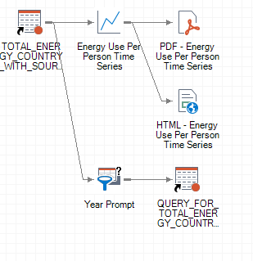
Key Features of the Framework
Developed a flexible analytical framework using the SAS® Enterprise Guide.
User-Driven Analysis:
Prompts were used to tailor the analysis to the user’s specific interests.
Users can select specific variables, a range of values for a variable, or a dataset location for customized investigation.
Customized Reports:
Framework produces tailored reports with highlighted total columns, enhancing visual appeal for the analysis team.
Comprehensive Framework:
Designed a wide range of complex queries related to energy consumption, population dynamics, and environmental impact.
Notes:
Key features of the framework are as follows:
We developed a flexible analytical framework using sas enterprise guide. user driven analysis was utilized for effective prompts. customized reports were also used to tailor the results. Finally comprehensive framework was designed to host a wide range of complex queries in an efficient manner

Slide 22
Future Research
For more in-depth research, all countries can be considered from both datasets
New variable for clean energy can be added because renewable energy does not always mean clean energy (i.e. biofuels)
Population density, with variations between sparse and densely populated countries.
A country's reliance on industry or agriculture is likely to impact its energy consumption trends.
Notes:
Future researchers are recommended that for a comprehensive analysis, it is beneficial to expand the scope to include all countries in both datasets. Additionally, introducing a new variable for clean energy is essential, as renewable energy does not always mean clean energy. Moreover, factors such as population density, with variations between sparse and densely populated countries, are expected to play a significant role. Furthermore, a country's reliance on industry or agriculture is likely to impact its energy consumption trends. These considerations underscore the need for a multifaceted approach to understand the complexities of global energy consumption patterns. Thank you.

Slide 23
Thank you!
gagana.udaykumar@my.utsa.edu
niharika.Bandlamudi@my.utsa.edu
nupoor.Karnik@my.utsa.edu
ki.Jeong@my.utsa.edu

